Slide 1
Foundation of computer science
By : Mohamed Agami

Slide 2

Lecture 19

Slide 3
Support 1/0 devices

Slide 4
Main Points for Connecting a Hardware Component to the Motherboard
Compatibility: Ensure the hardware component is compatible with the motherboard regarding slots and frequencies.
Auto-Detection: The system relies on BIOS/UEFI to recognize new devices.
Power Supply: Verify that the motherboard and power supply provide enough power for the device.
Drivers: Install the proper drivers to ensure the device functions correctly.
Device Configuration: Adjust settings via BIOS or the operating system.
Device Testing: Confirm the device operates correctly after installation.
Resource Management: Ensure the device does not conflict with other hardware in terms of resource allocation.
Cooling: Provide adequate cooling for components that generate heat.
Physical Security: Ensure the component is securely and properly installed on the motherboard.
Updates and Compatibility: Update BIOS or the operating system to ensure full compatibility

Slide 5
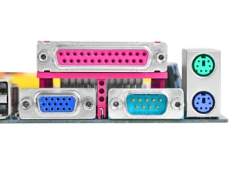
Serial , parallel and ps/2

Slide 6
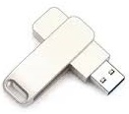
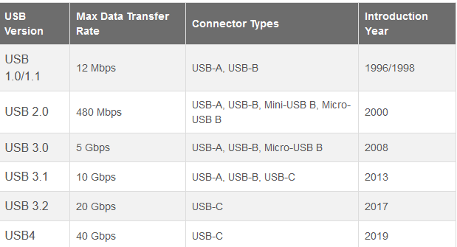
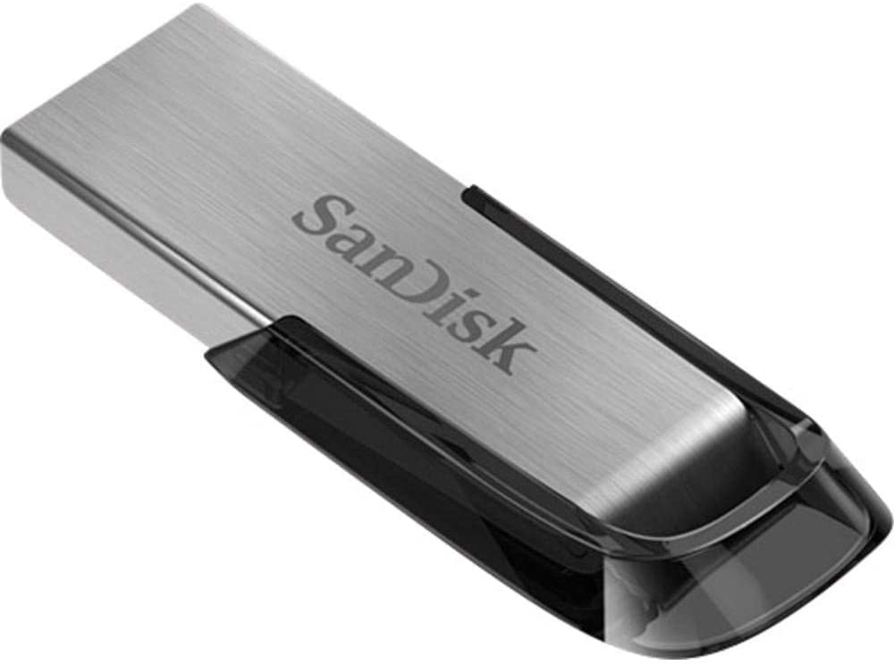
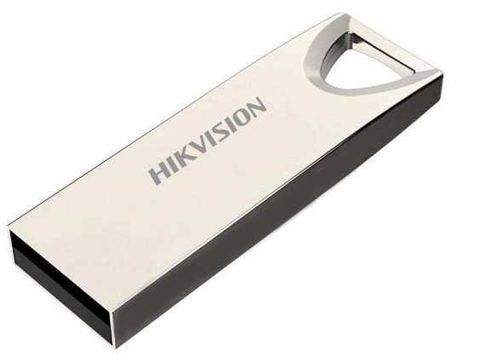
Universal serial bus (USB)
USB 1 and USB 1.1
Speed : 12Mbs
USB 2
Speed : 480Mb2
USB 3 , 3.1 and 3.3
Speed : 5,10,20Gb2

Slide 7
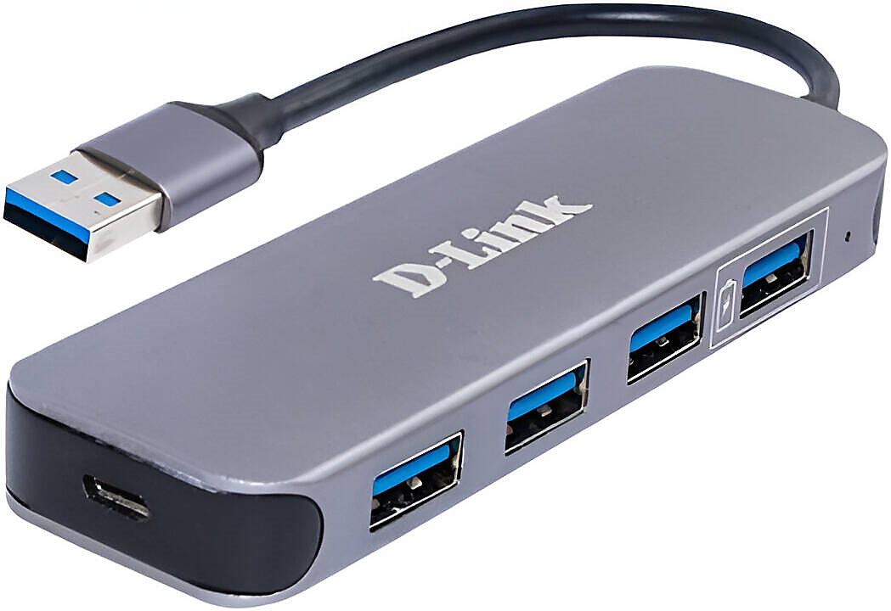
USB Hub
A device used to expand the number of USB ports on a computer, allowing multiple devices to be connected to a single USB port. Some hubs come with an external power source to support devices that require extra power.

Slide 8
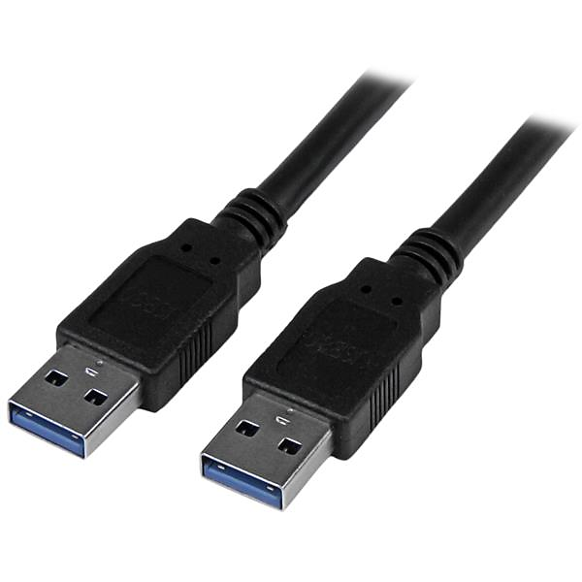
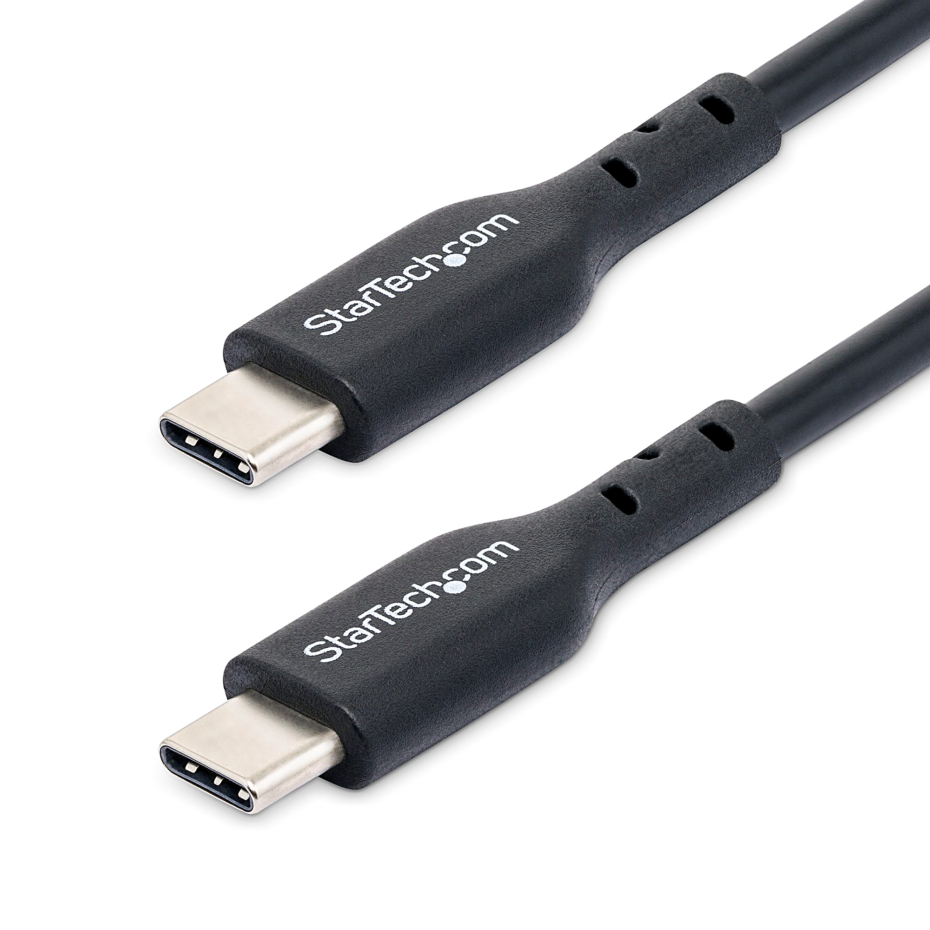
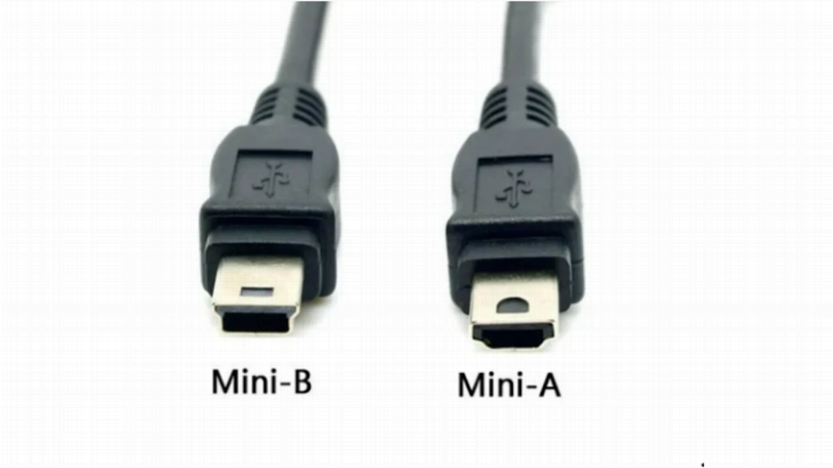
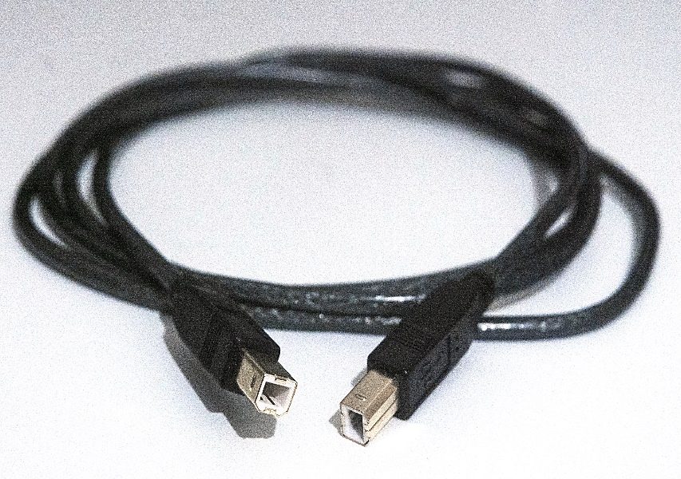
USB connector
USB Type-A
Common in computers, TVs, gaming consoles, keyboards, mice, flash drives, and more.
USB Type-C
Used in smartphones, laptops, chargers, docking stations, and supports faster data transfer and power delivery.
Mini USB
Type-A and Type-B, but larger than Micro USB.
Uses: Previously common in older electronics like digital cameras and portable gaming devices.
USB Type-B
Typically used in printers, scanners, and other external devices.

Slide 9
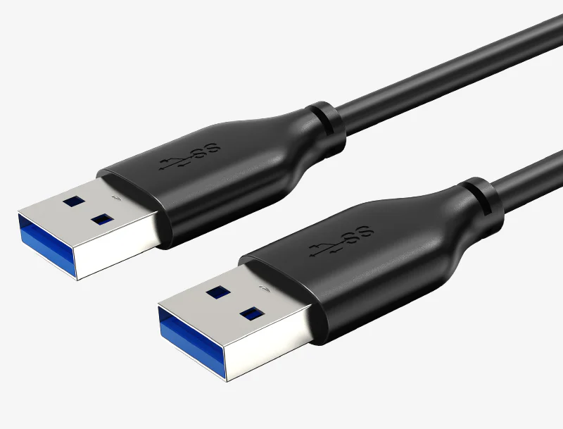
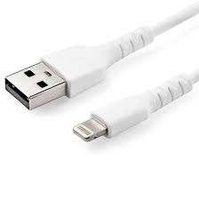
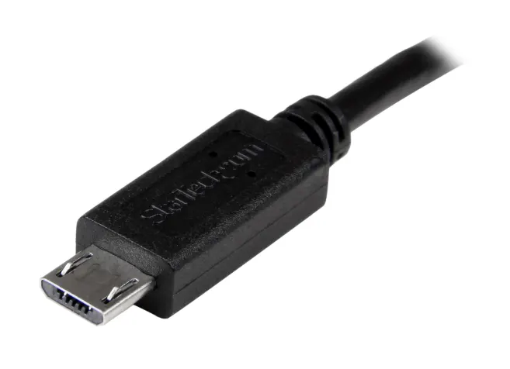
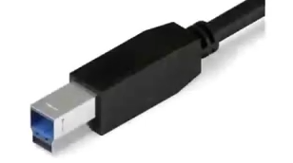
USB connector
Micro USB
Used in older smartphones, gaming controllers, and some digital cameras
USB Lightning
Used in Apple devices like iPhones and iPads for charging and data transfer..
USB 3.0 Type-A
Used in external storage devices like hard drives, flash drives, and computers that support faster data transfer
USB 3.0 Type-B
Used in high-speed external storage devices and printers

Slide 10
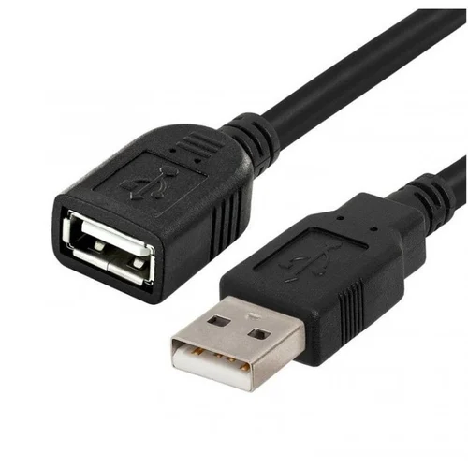
Male to Female USB Connector

Slide 11
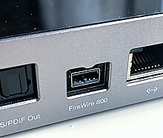
FireWire (IEEE 1394)
FireWire (IEEE 1394) is a high-speed data transfer standard developed by Apple, primarily used in audio and digital video devices. It features direct device-to-device communication, hot-swapping, and power transfer. It has largely been replaced by interfaces like USB 3.0 and Thunderbolt.

Slide 12
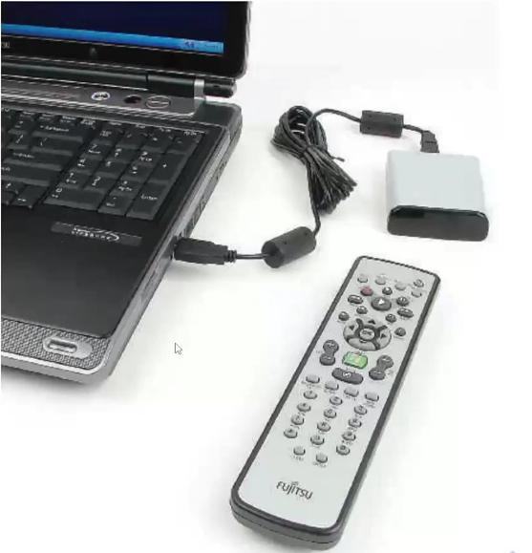
Infrared Connection

Slide 13
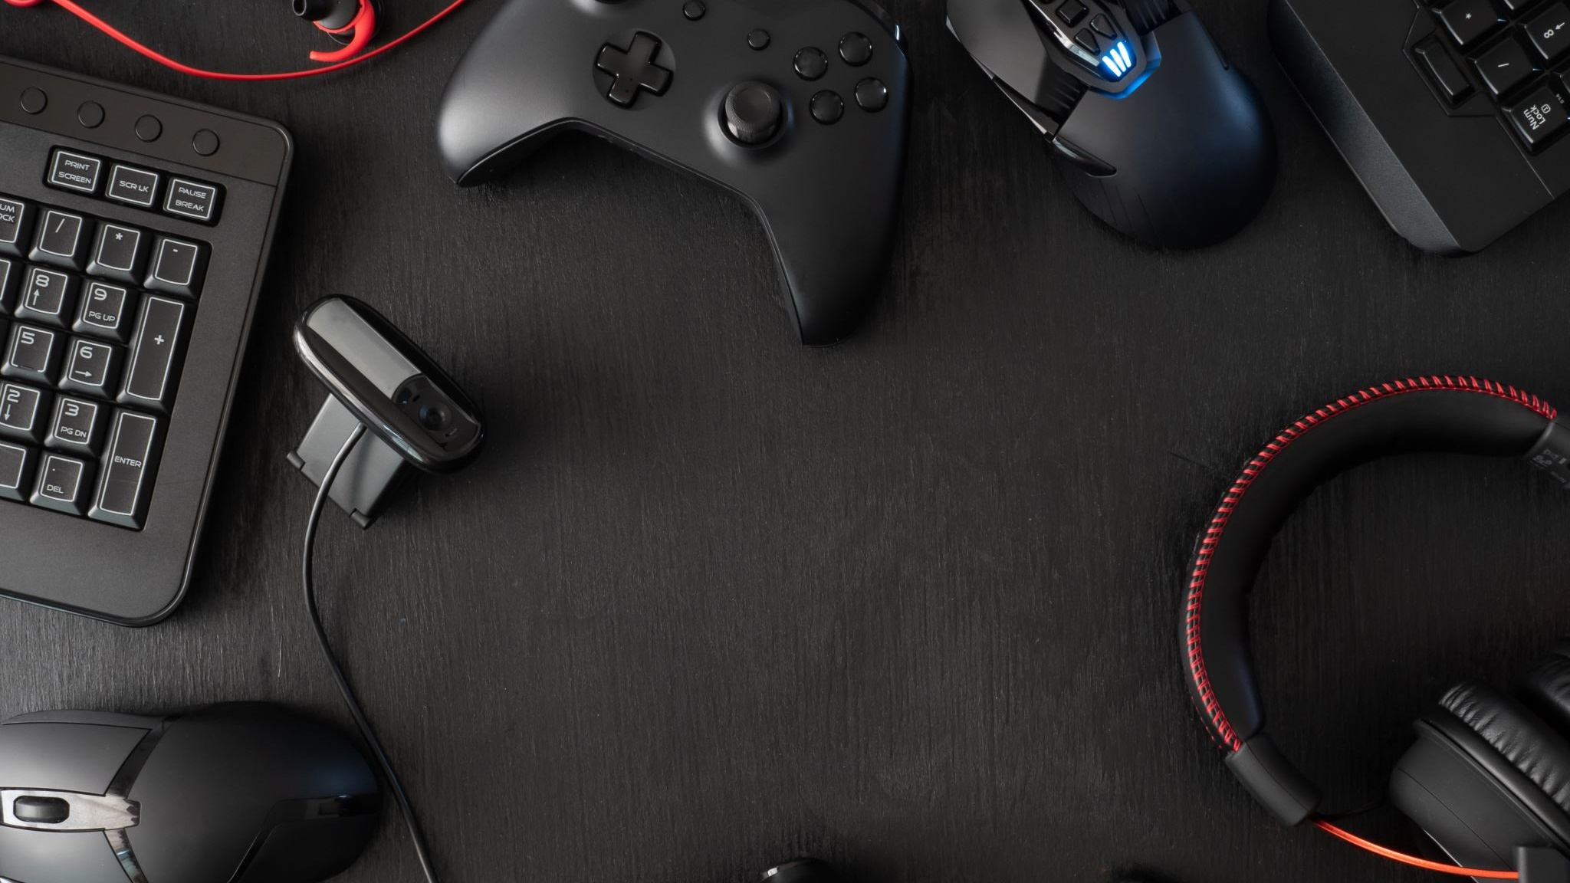
Peripheral device

Slide 14
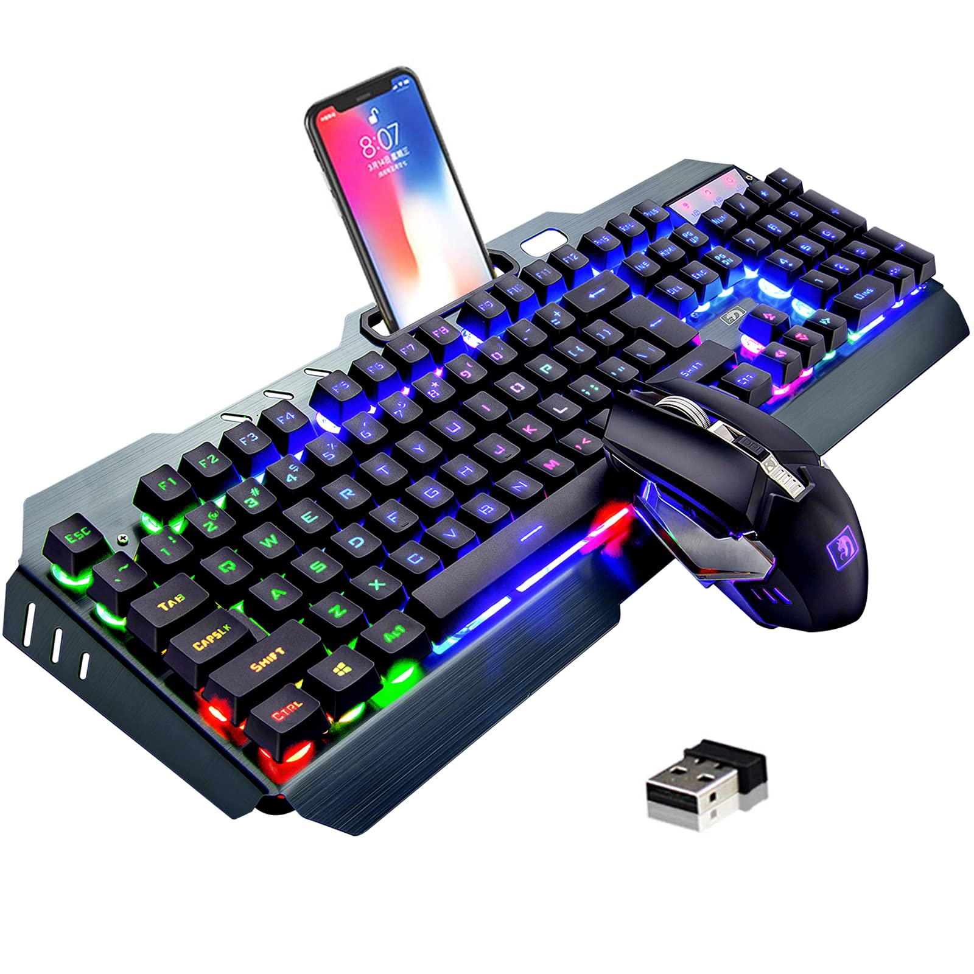
Keyboard and mouse

Slide 15
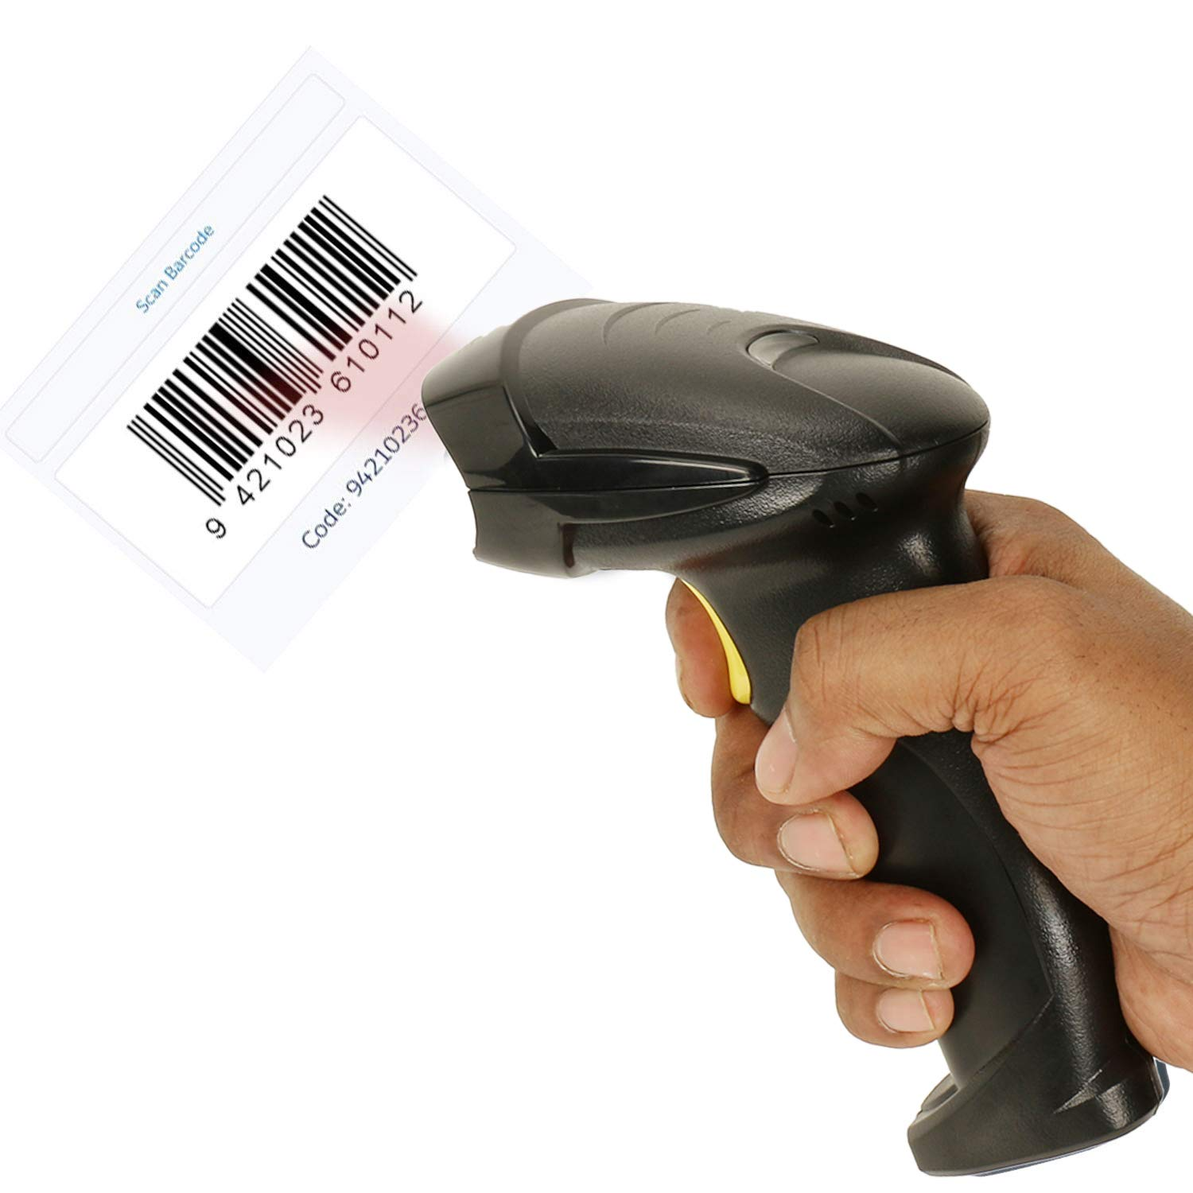
barcode reader

Slide 16
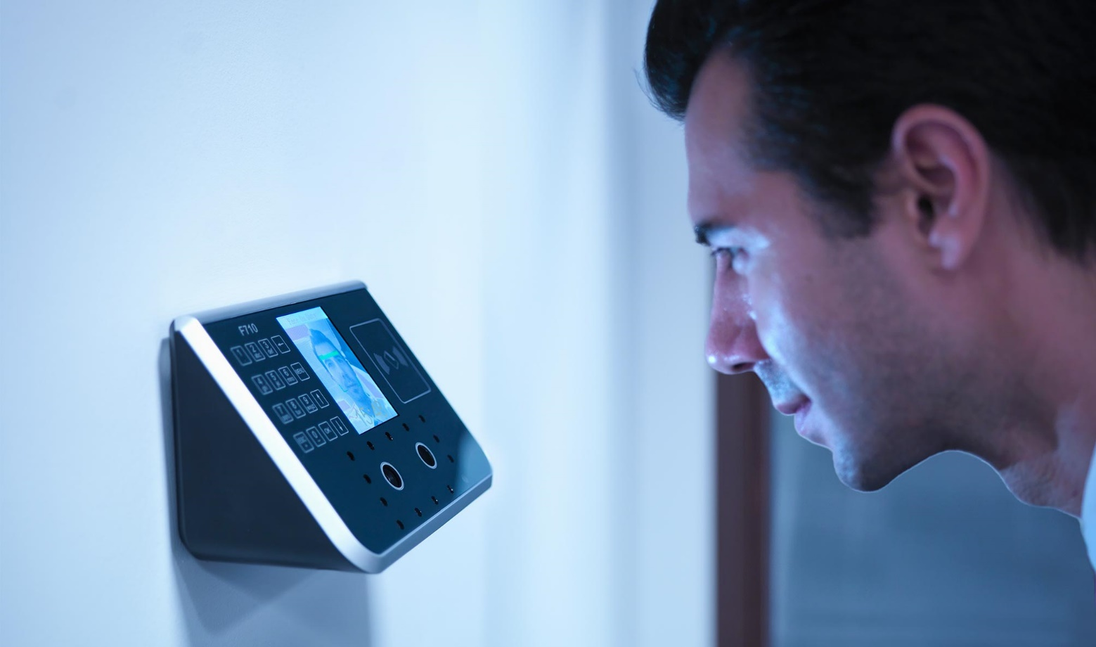
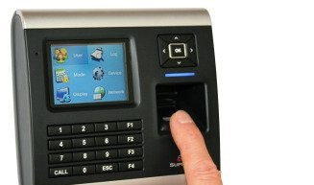
barcode reader

Slide 17
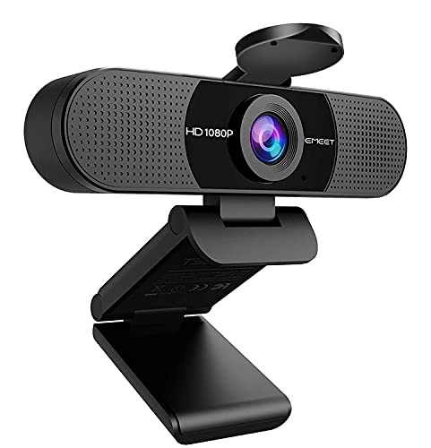
Webcams
Webcams are small cameras connected to a computer or network that capture video and sometimes audio, allowing for real-time communication, video recording, and broadcasting. They’re commonly used for video calls, live streaming, security, and content creation. Webcams typically connect via USB, though some are wireless, and they range in quality from basic 720p resolution to high-definition 4K models. Built-in webcams are common in laptops, while external webcams are popular for desktops and specialized setups, often featuring additional enhancements like autofocus, adjustable angles, and background effects for a seamless experience.

Slide 18
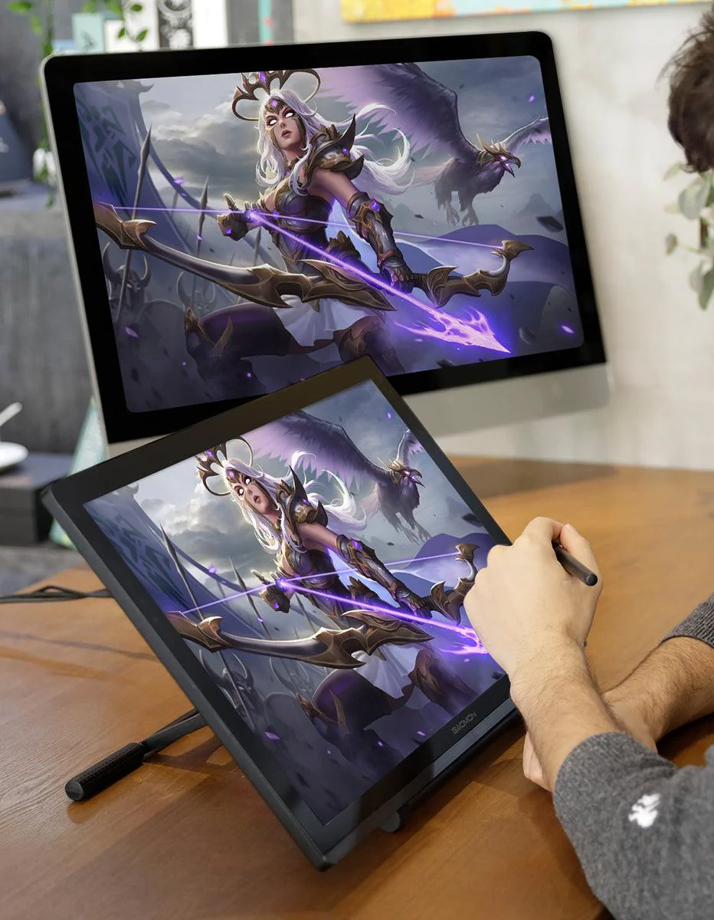
Graphic Tablet
A graphic tablet (or drawing tablet) connects to a computer to allow artists and designers to create digital artwork using a stylus or pen. These tablets typically connect via USB, Bluetooth, or wireless adapters, depending on the model. Once connected, the tablet allows users to draw directly on its surface, and the input is reflected on the computer screen. Graphic tablets are widely used for tasks like digital painting, photo editing, and 3D modeling due to their precision and pressure-sensitive capabilities, making them ideal for creative work. Popular brands include Wacom, Huian, and XP-Pen.

Slide 19
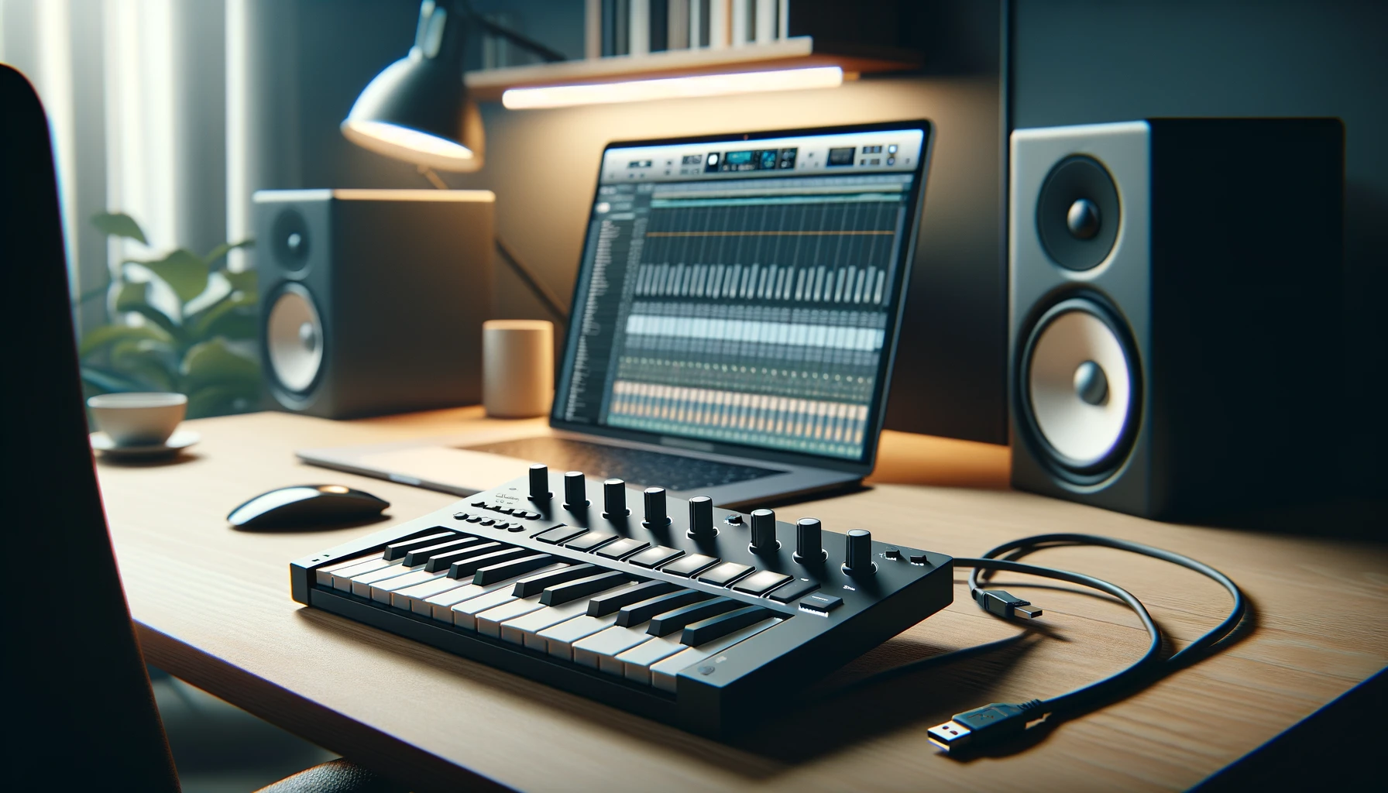
MIDI device
A MIDI (Musical Instrument Digital Interface) device is a hardware or software tool used for creating, recording, and controlling music through digital signals. MIDI allows electronic musical instruments, computers, and other devices to communicate with each other, transmitting data such as pitch, volume, and timing of musical notes. Common MIDI devices include keyboards, drum pads, MIDI controllers, and audio interfaces. These devices don't produce sound on their own but send MIDI data to sound generators, synthesizers, or software that converts the digital signals into audible sounds. MIDI is widely used in music production, live performances, and sound design.

Slide 20
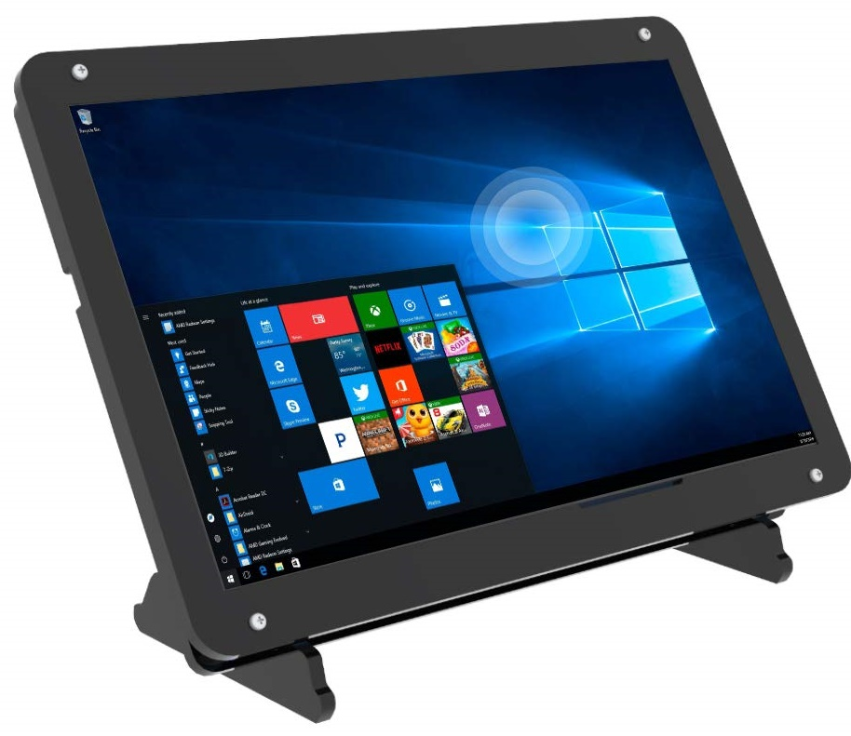
Touch Screen
A touch screen in a computer is an input device that allows users to interact with the computer by touching the screen directly. It works by detecting the location of a touch, whether it's from a finger or a stylus, and translating it into commands or actions. Touch screens are commonly used in laptops, tablets, and all-in-one desktop computers. They can support multi-touch gestures, enabling users to zoom, scroll, rotate, and perform other actions with multiple fingers simultaneously. Touch screens provide a more intuitive and interactive way to use devices compared to traditional mouse and keyboard inputs.

Slide 21
Install and confiding adapter card

Slide 22
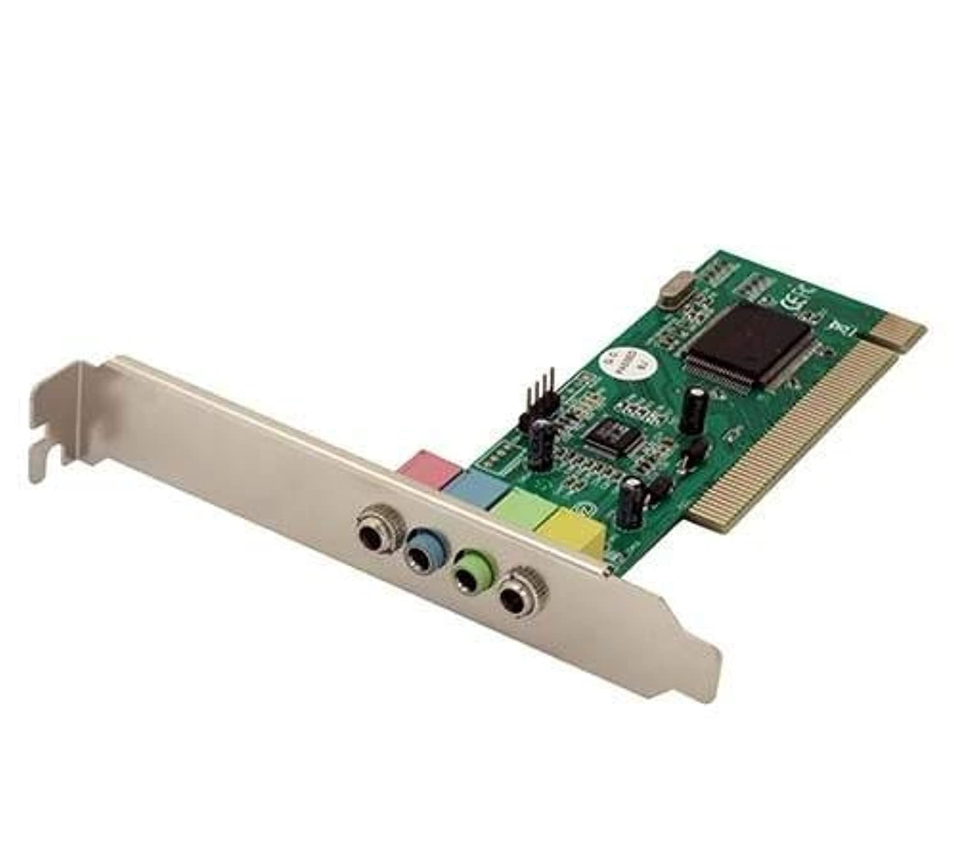
Sound card

Slide 23
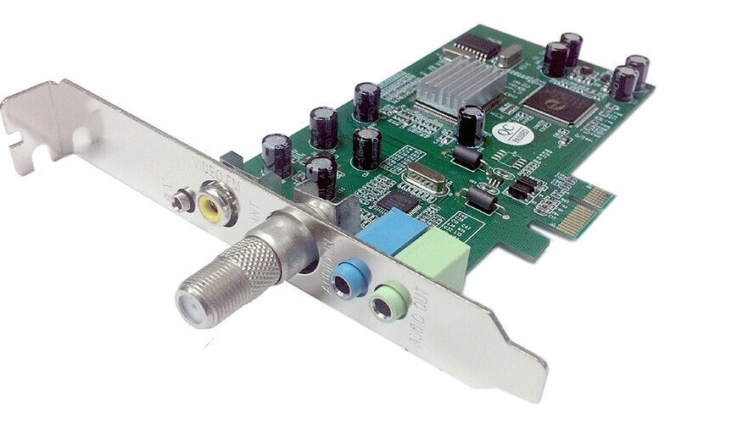
TV tuner and video capture card

Slide 24

Tank you

